Slide 1
I211 – Information Infrastructure II
Lecture 5

Slide 2
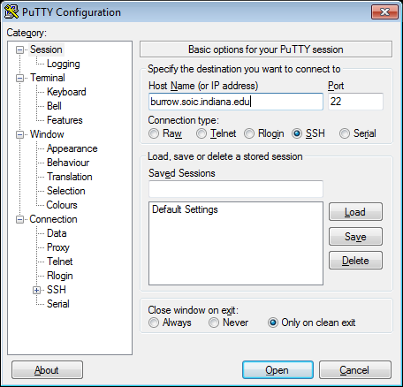
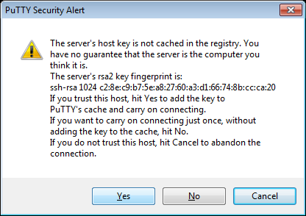
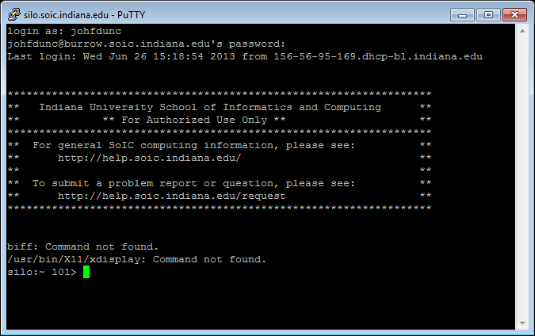
Test for Tomorrow
Try to use PuTTY to connect to burrow.soic.indiana.edu
Log in as yourself!

Slide 3
List Comprehensions
We can turn any situation in which we’d write:
some_list = []
for item in sequence:
some_list.append(<pattern based on item>)
into:
some_list = [<pattern based on item> for item in sequence]

Slide 4
List Comprehensions
We can turn any situation in which we’d write:
some_list = []
for item in sequence:
if <boolean expression>:
some_list.append(<item pattern>)
into:
some_list = [<item pattern> for item in sequence if <boolean expression>]

Slide 5
List Comprehensions
A X B = {(a, b) | a ∈A ∧ b ∈B}
set_a = [0,1,2,3]
set_b = ["A", "B"]
To create A X B as a list, we could do this:
a_cross_b = []
for num in set_a:
for let in set_b:
a_cross_b.append((num, let))
Or we could use a list comprehension:
a_cross_b = [(num, let) for num in set_a for let in set_b]

Slide 6
List Comprehensions
We can turn any situation in which we’d write:
some_list = []
for item1 in sequence1:
for item2 in sequence2:
some_list.append(<item1 & item2 pattern>)
into:
some_list = [<item1 & item2 pattern> for item1 in seq1 for item2 in seq2]

Slide 7
List Comprehensions
File objects are sequences!
Old:
read_file = open("numbers.txt", "r")
file_contents = read_file.readlines()
print file_contents
read_file.close()
New:
file_contents = [line for line in open("numbers.txt", "r")]
print file_contents #note we don’t have to close this read!

Slide 8
Two Vowels (Group Work)
Use list comprehensions to mimic this exchange:
>>>
Please enter a file name: words.txt
All words in the file: ['The', 'quick', 'brown', 'fox', 'jumps', 'over', 'the', 'lazy', 'dog']
The words in the file that contain 2 or more vowels: ['quick', 'over']
HINT: You can nest list comprehensions, since a list is a sequence!!

Slide 9
Two Vowels (Solution 1)
def two_vowels(string):
count = 0
for let in string:
if let in "aeiou":
count += 1
return count >= 2
file_name = raw_input("Please enter a file name: ")
all_words = [line.strip() for line in open(file_name, "r")]
file_contents = [line.strip() for line in open(file_name, "r") \
if two_vowels(line)]
print "All words in the file: ", all_words
print "The words in the file that contain 2 or more vowels:", file_contents

Slide 10
Two Vowels (Solution 2)
file_name = raw_input("Please enter a file name: ")
all_words = [line for line in open("test.txt", "r").read().strip().split()]
file_contents = [line for line in open("test.txt", "r").read().strip().split() \
if len([let for let in line if let in "aeiou"]) >=2]
#nested list comprehension!!
print "All words in the file: ", all_words
print "The words in the file that contain 2 or more vowels:", file_contents

Slide 11
List Comprehensions
We can also change the template a bit in order to use else:
Old:
phrase = "I had a nice walk this afternoon, until it began to rain."
new = ""
for ch in phrase:
if ch == "a":
new += "A"
else:
new += ch
print new
Outputs:
I hAd A nice wAlk this Afternoon, until it begAn to rAin.

Slide 12
List Comprehensions
We can also change the template a bit in order to use else:
New:
phrase = "I had a nice walk this afternoon, until it began to rain."
print "".join(["A" if ch == "a" else ch for ch in phrase])
Outputs:
I hAd A nice wAlk this Afternoon, until it begAn to rAin.

Slide 13
List Comprehensions
We can turn any situation in which we’d write:
sequence = empty
for item in sequence:
if <boolean expression>:
sequence += <pattern 1>
else:
sequence += <pattern 2>
into:
sequence = [<pattern 1> if <boolean expression>
else <pattern 2> for item in sequence]

Slide 14
Censorship (Group Work)
Use list comprehensions to mimic this exchange:
>>>
Please enter the secret: This is an important secret! Don't tell anyone!
Redacted: ---- -- -- --------- ------! ---'- ---- ------!
HINT: There is a string method called .isalpha() that does the same thing for letters that .isdigit() does for numbers!!

Slide 15
Censorship (Solution)
unredacted = raw_input("Please enter the secret: ")
print "Redacted: ", "".join(["-" if ch.isalpha()
else ch for ch in unredacted])

Slide 16
L337 5p34k (Group Work)
Use list comprehensions to mimic this exchange:
>>>
Please enter the phrase to translate: 7h15 15 4 t357
Output: this is a test
HINT: Use a dictionary to manage the translations:
1 -> i
3 -> e 4 -> a 5 -> s 7 -> t

Slide 17
L337 5p34k (Solution 1)
leet = raw_input("Please enter the phrase to translate: ")
leet_dict = {"1": "i", "3": "e", "4": "a", "5": "s", "7": "t"}
print "Output:", "".join([ch if ch.isalpha() or ch == " "
else leet_dict[ch] for ch in leet])

Slide 18
L337 5p34k (Solution 2)
leet = raw_input("Please enter the phrase to translate: ")
leet_dict = {"1": "i", "3": "e", "4": "a", "5": "s", "7": "t"}
print "Output:", "".join([leet_dict[ch] if ch in leet_dict \
else ch for ch in leet])

Slide 19
Questions?

